Slide 1
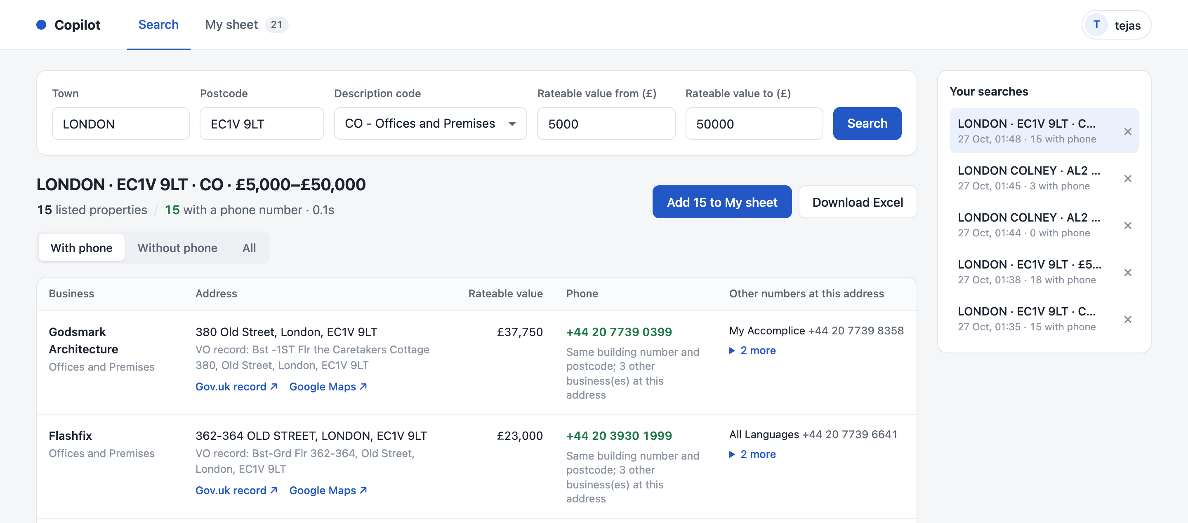
Find UK business phone numbers in seconds, not hours
COPILOT
How Copilot builds your team’s call list automatically
1,012
2.8 sec
phone numbers found
for one whole Coventry postcode area
Demo · October 2026
Notes:
Copilot takes the job your callers do by hand today — finding businesses and their phone numbers — and does it automatically. One search for the Coventry CV1 area (rateable value £12,000 and above) checked 1,178 properties and found 1,012 phone numbers in under three seconds.

Slide 2






Today, every contact is found by hand in four steps
Step 1
Step 2
Step 3
Step 4
Search the government site
Copy each address
Look it up on Google Maps
Paste into the sheet
Enter town, postcode and rateable value on the business-rates website
Open every property and copy its address, one by one
Find which business is there and its phone number
Type the name, address and number into Google Sheets
2–3 hours
for one person to build a list of 50–60 contacts — repeated for every single business, every day.
Notes:
This is the process the team follows today. Every contact needs four manual steps, and building a list of 50 to 60 contacts takes one person two to three hours.

Slide 3


Across 15 callers, that is a lot of time not spent calling
45 hours
225 hours
≈ 6 people
every day
every week
full-time
15 callers × 3 hours each spent finding numbers
45 hours × 5 working days
225 hours is the working week of about six full-time staff (37.5 hours each)
Time spent copying and pasting is time not spent on calls that win business.
Notes:
Based on 15 callers each spending about three hours a day finding numbers. That is 45 hours every day, 225 hours a week — roughly the working week of six full-time people — spent on data entry instead of calls.

Slide 4




Copilot does all four steps in one search
Searches the government rates list
Same choices as the website: town, postcode, description, rateable value
Real example
Coventry · CV1 · rateable value £12,000+
Skips removed properties
1,178
Only properties still listed with a current valuation are kept
properties checked
Finds the business and its phone number
1,012
Matched by postcode, building number and street — written as +44
phone numbers found
Builds the Excel sheet
2.8 seconds
Only properties with a phone number, in your usual columns
from clicking Search to results
Notes:
One search replaces all four manual steps. In this real example Copilot checked every listed property in Coventry CV1 with a rateable value of £12,000 or more — 1,178 properties — and found phone numbers for 1,012 of them in under three seconds.

Slide 5
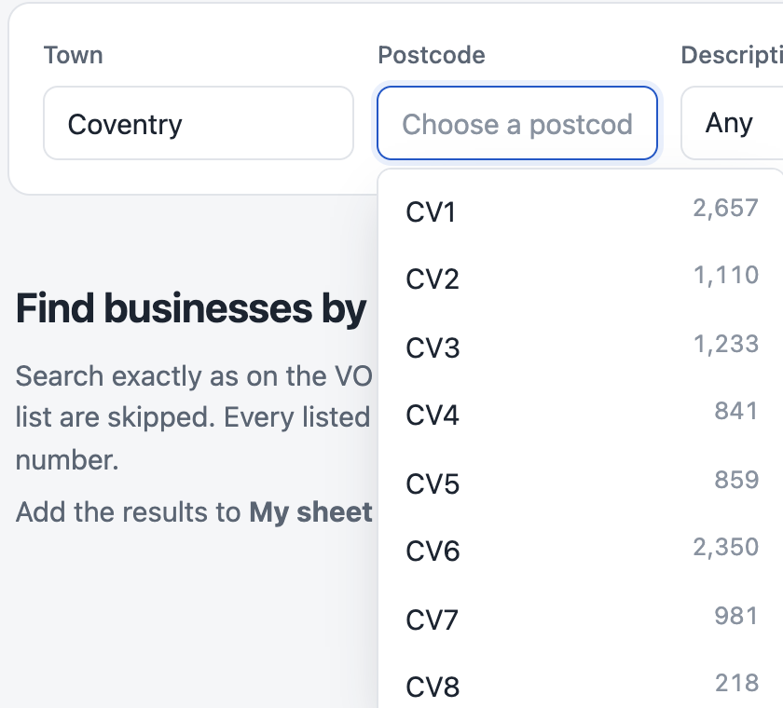

Search exactly like the government site
Choose a town and the postcode list fills in, with the number of properties in each
Removed properties skipped automatically
Phone numbers with the +44 country code
Gov.uk and Google Maps links to check
Notes:
The search page has the same fields as the government website. Pick a town and the postcode list fills in automatically. Each result shows the business, its address, rateable value and phone number, plus links to the official record and Google Maps so the caller can double-check.

Slide 6
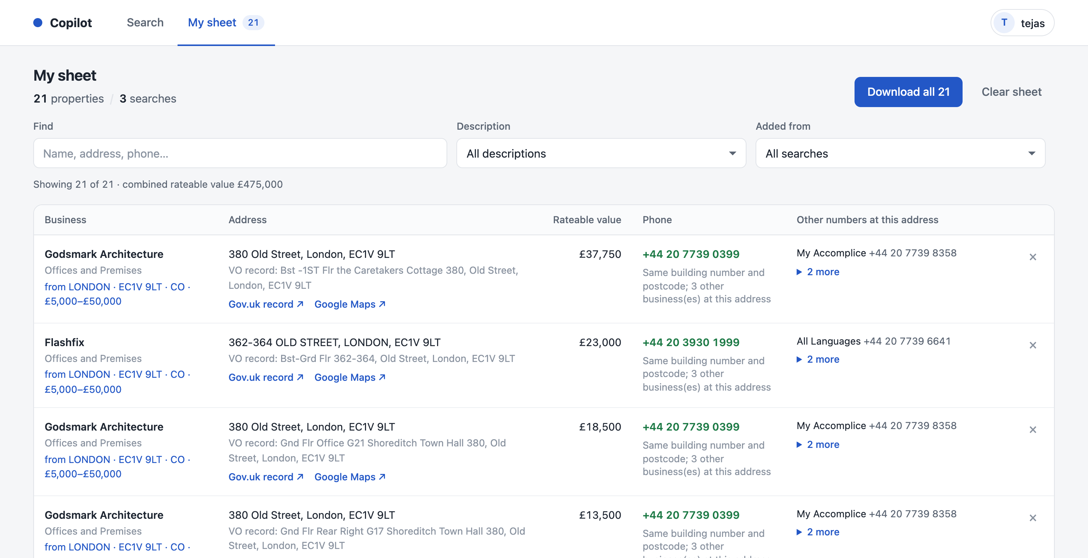
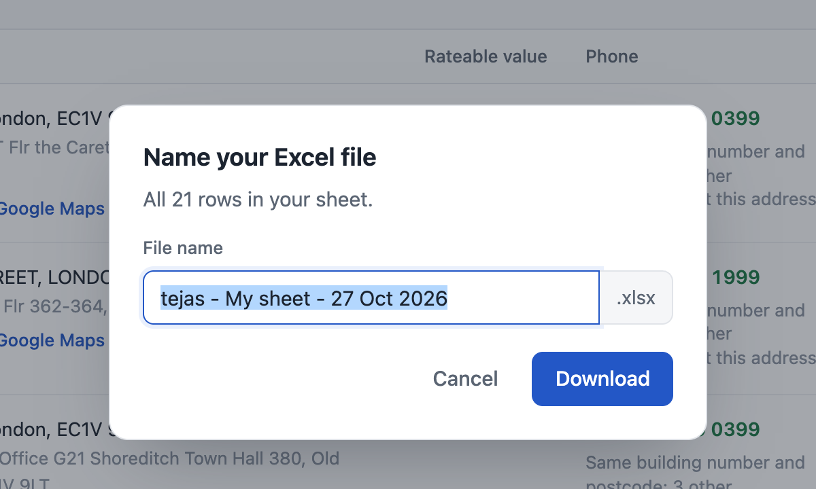


Build one call list from many searches in My sheet
Add any search with one click — duplicates are skipped
Filter by description, search or text
Each employee has their own sheet and search history; the employee’s name becomes the default file name.
Download everything, or just what you filtered, with your own file name
Notes:
Callers add each search to their own sheet with one click — 25 businesses from one search, 25 from the next, and so on. They can filter the sheet and download it as an Excel file with a name they choose; by default the file is named after the employee.

Slide 7
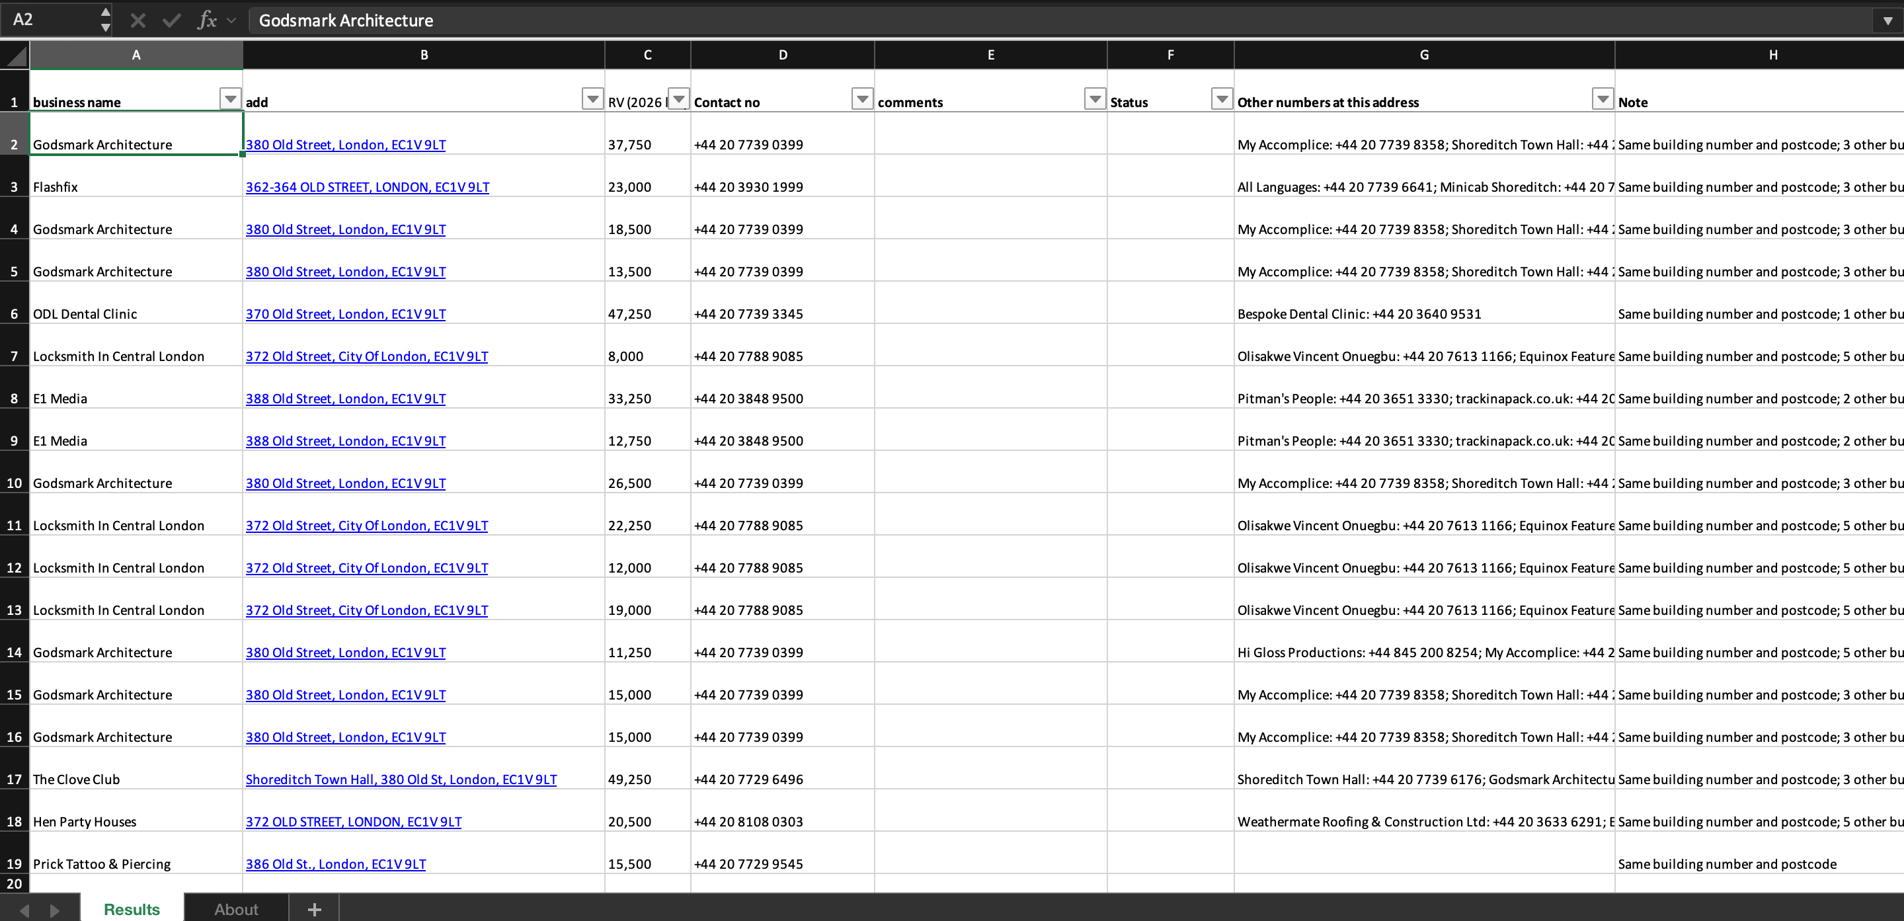


The result: a ready-to-call Excel sheet
Your usual columns
Business name, address, rateable value, contact number, comments
Ready for callers
Comments and Status are left empty to fill in during calls
A next number to try
Other businesses at the same address, with their numbers
A real file downloaded from Copilot — London EC1V 9LT, offices, rateable value £5,000–£50,000
Notes:
This is a real file downloaded from Copilot. It keeps the columns the team already uses — business name, address, rateable value, contact number and comments — with Status left empty for callers, and extra columns such as other numbers at the same address.

Slide 8
Before and after
 | Today (by hand) | With Copilot
Building a 50–60 contact list | 2–3 hours | About a minute
Steps per contact | 4 copy-and-paste steps | None — one search
Removed properties | Checked by hand | Skipped automatically
How many per search | One property at a time | Every listed property in the area
Typing mistakes | Easy to make | Copied straight from the source
Getting the Excel sheet | Built by hand | One click, named your way
“Today” figures are the team’s current process; Copilot figures come from a real search.
Notes:
Side by side: what took two to three hours of manual copying now takes about a minute, with every listed property in the area checked at once.

Slide 9






Where the numbers come from
Government rating list
The official list of every business property in England and Wales — 2.1 million properties with addresses and rateable values
Copilot
Call list
Public business listings
on your office computer
ready to download
4 million UK business listings with names and phone numbers, published openly by the Overture Maps Foundation (Amazon, Meta, Microsoft, TomTom)
Updates itself
Nothing to get blocked
Free to run
Checks every day and installs new data overnight
No Google scraping and no paid APIs
One office computer serves the whole team
Notes:
Copilot uses two public sources: the government’s official rating list and openly published business listings. Both are kept on the office computer and refreshed automatically each month, so searches don’t depend on Google or any paid service — there is nothing to get blocked and nothing to pay for.

Slide 10


Good to know
Shared buildings
Monthly data
One address can hold several businesses. The most likely number is given, with the others listed — callers confirm who answers.
Listings are refreshed monthly, so a very new business or changed number may be missing. The Google Maps link is there to check.
TPS screening
Coverage
Before sales calls, numbers must still be checked against TPS and CTPS. Copilot does not do this step.
Busy areas give the most numbers (1,012 of 1,178 in Coventry CV1); industrial estates usually give fewer.
Notes:
A few honest points. Shared buildings can list several businesses at one address, so callers should confirm who answers. Data is refreshed monthly. Numbers still need TPS/CTPS screening before sales calls. And the share of properties with a phone number is highest in busy commercial areas.

Slide 11
More time calling, less time searching
NEXT STEPS
1
Set up on one office computer
Free — the whole team opens it in their browser
2
Show the team
A ten-minute walkthrough is enough
Copilot turns hours of copy-and-paste into one search
3
Measure the difference
Compare calls per caller per day, before and after
Notes:
Next steps: set Copilot up on one office computer at no cost, give the team a short walkthrough, and compare the number of calls per caller before and after.

